Slide 1
Barriers to Implementing a Just Culture
Kimberly Orozco
November 1, 2025
CSD380-T301 DevOps

Slide 2
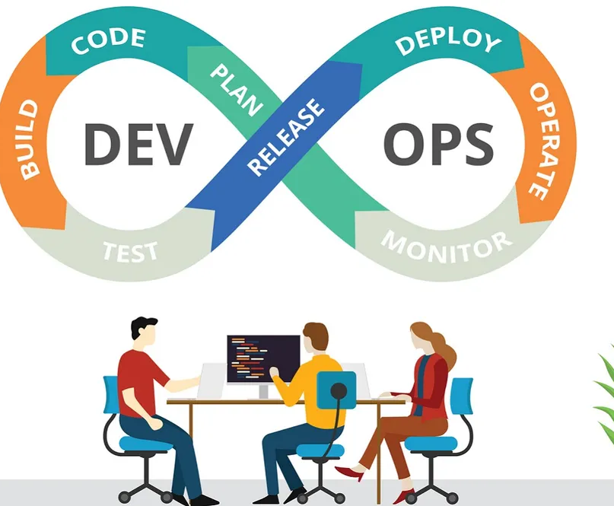
Introduction
________________________________
________________________________
DevOps is centered around teams working together and is built on the foundation of proper communication.
Just Culture is about being fair to people and not punishing them for honest mistakes.
But putting both of these into practice is not easy. There are many challenges that make it hard for companies to do it the right way.

Slide 3
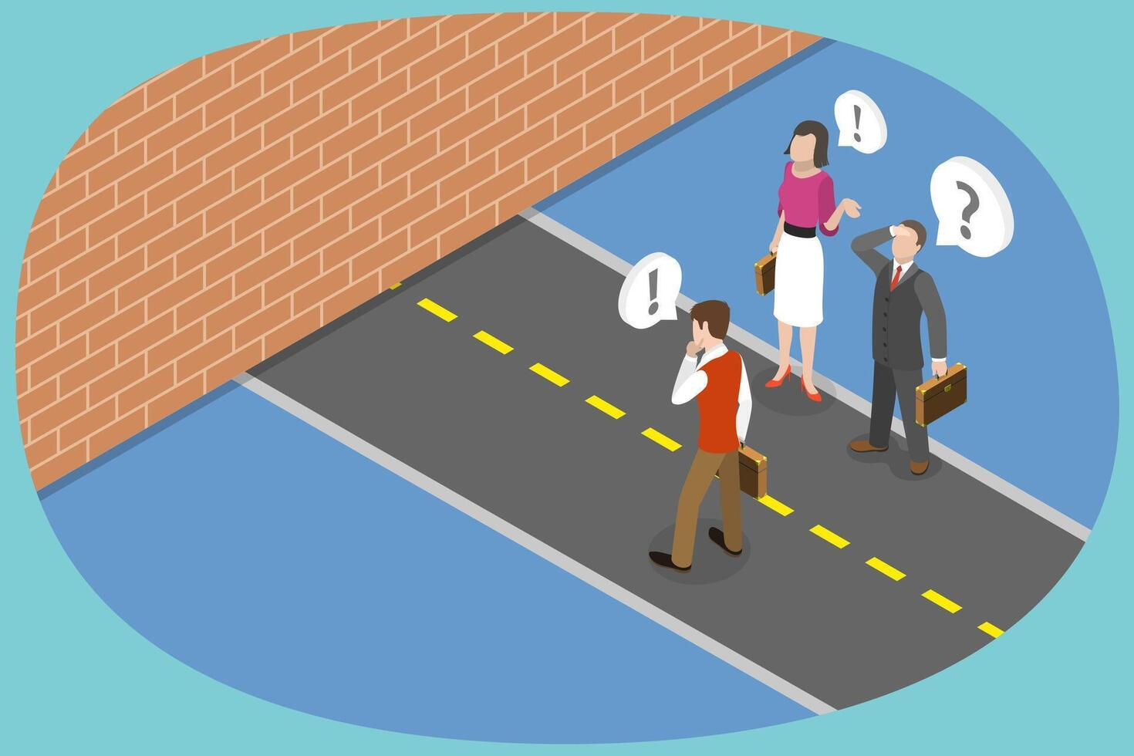
Conceptual Barriers
You can’t create a culture by making rules. Culture grows slowly over time. Just Culture is not really a rule it’s more about starting conversations about fairness and safety.
Challenges:
Changing shared beliefs and habits takes a long time.
Different teams think about fairness in different ways.

Slide 4

Personal and Social Barriers
People judge mistakes differently depending on what happens and who is affected.
Trust is fragile and one bad manager can ruin progress.
Some people naturally think that any mistake should be punished.
People’s past experiences affect how they react to mistakes.

Slide 5
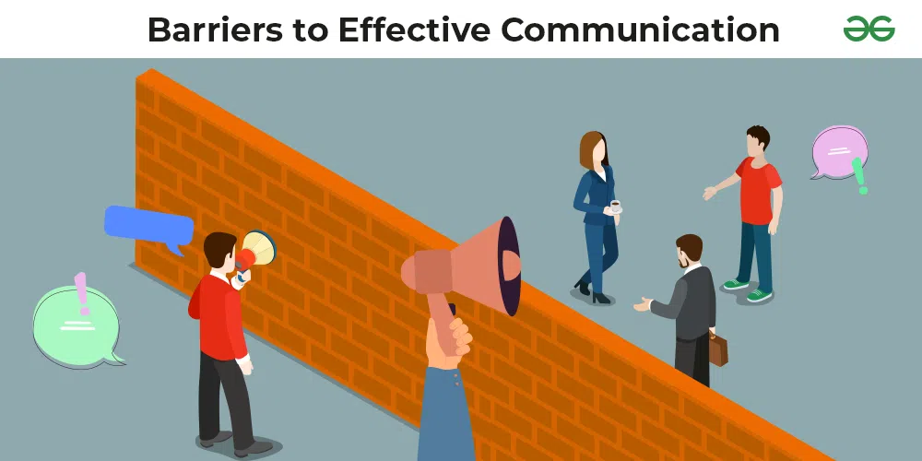
Professional and Organizational Barriers
Different jobs see mistakes in different ways! Engineers, managers, and nother professionals all have their own different ideas of what is acceptable. This can affect the overall work environment for those around them.
Other problems:
People worry about what their coworkers or outsiders will think.
Companies sometimes give examples of bad behavior that stick in people’s minds.

Slide 6
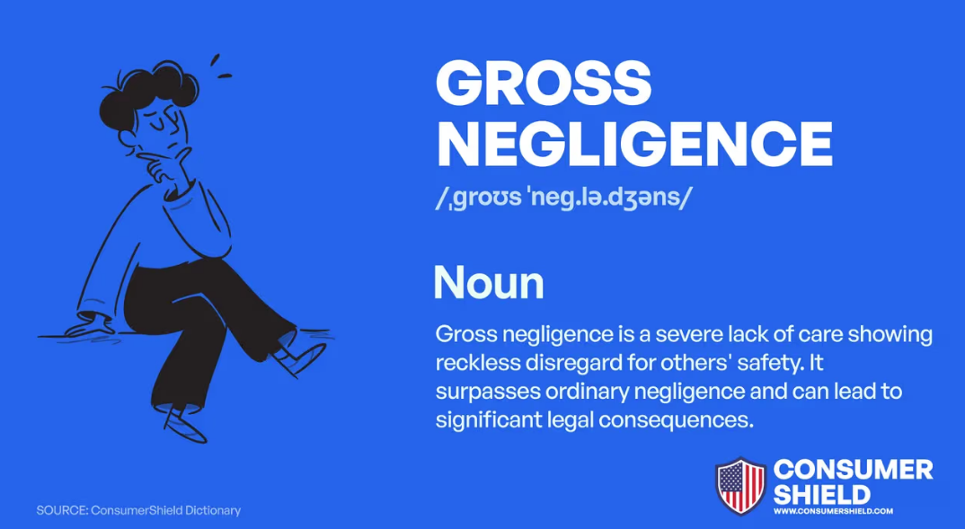
Legal and Regulatory Barriers
Laws and rules sometimes force companies to punish mistakes, even if they are honest. Words like “gross negligence” are confusing and open to interpretation (Shorrock, 2023). This makes it hard to fully practice Just Culture because fairness can conflict with legal requirements.

Slide 7
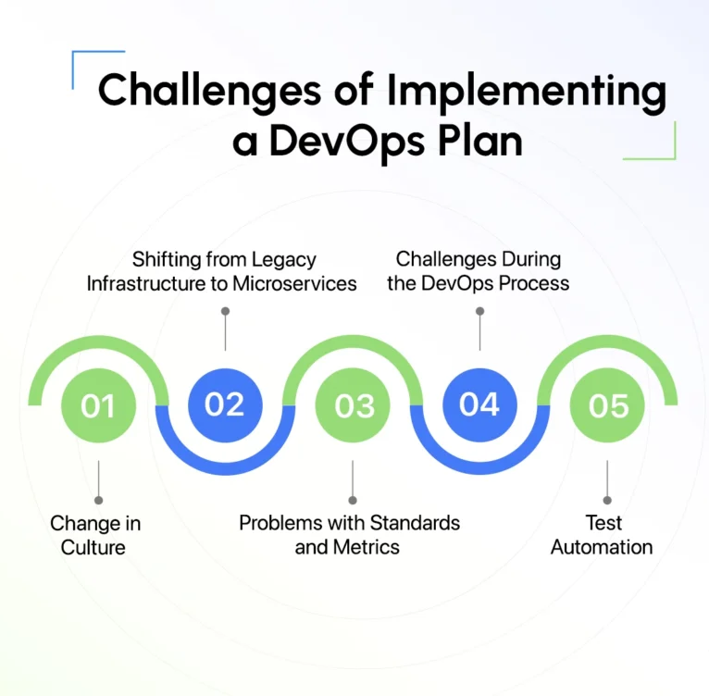
DevOps Challenges
Even adopting DevOps has it’s own challenges. Teams are used to old habits and might resist changes. It can also be hard to find people with the right skills.
Challenges:
Manual work slows everything down and increases mistakes.
Security has to be constantly monitored to avoid problems.

Slide 8
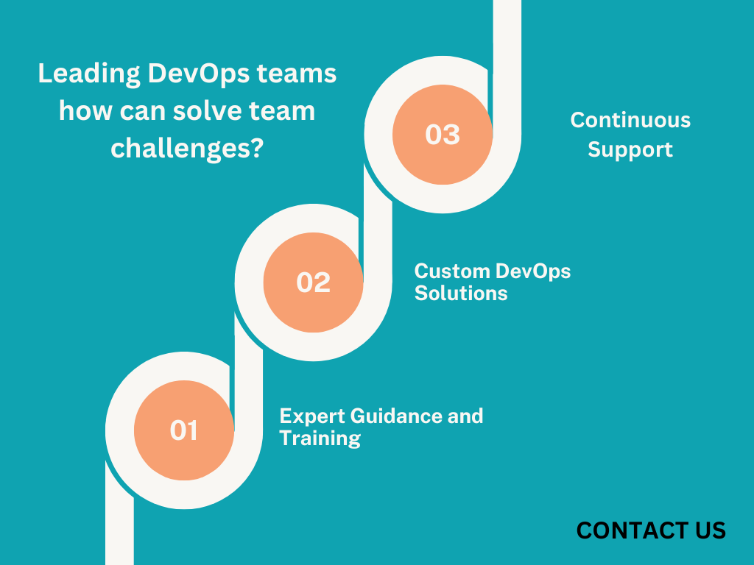
Overcoming Challenges
Build a culture of teamwork and shared responsibility.
Train team members and help them improve their skills.
Automate tasks to reduce mistakes and save time.
Encourage feedback, learning, and fixing problems without blaming people.

Slide 9
Works Cited
Shorrock, S. (2025, October 30). Why is it just so difficult? barriers to “just culture” in the real world. Humanistic Systems. https://humanisticsystems.com/2023/10/18/why-is-it-just-so-difficult-barriers-to-just-culture-in-the-real-world/
Vasiliev, D. (2024, July 30). Overcoming common devops challenges in implementing devops: Solutions for Success. Attract Group. https://attractgroup.com/blog/overcoming-common-devops-challenges-in-implementing-devops-solutions-for-success/

